Slide 1
Architecting Waferscale Processors
topics in HPC

Slide 2
Contents
The reason I chose
Today’s Architecture

Slide 3
Today’s Architecture
In this paper, we study if it is feasible and useful to build today’s architectures at waferscale.

Slide 4
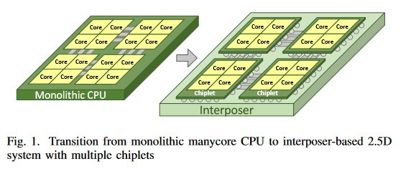
Today’s Architecture
Monolithic Architectures

Slide 5
Today’s Architecture
Power overhead of IO circuitry to support chip-to-chip communication exceeds 30% on some processors.
Communication energy, Latency, Bandwidth scale much worse than computation.

Slide 6
Approach
energy-proportional communication fabrics
in-memory computational models
near-memory computational models
communication avoiding algorithms
2.5D integration
3D integration

Slide 7
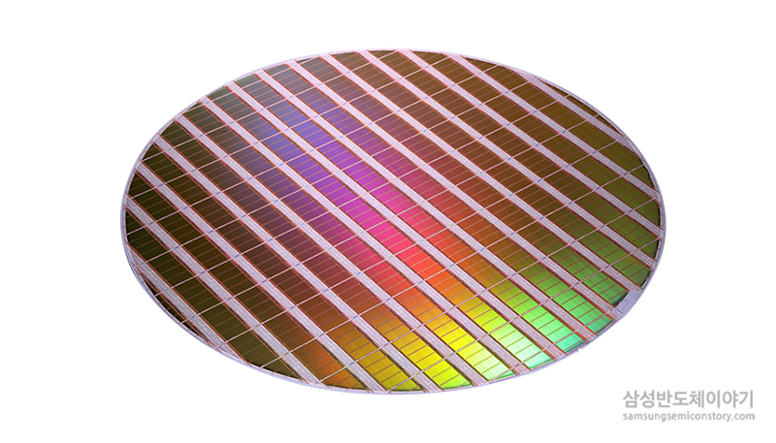
Waferscale Processors

Slide 8
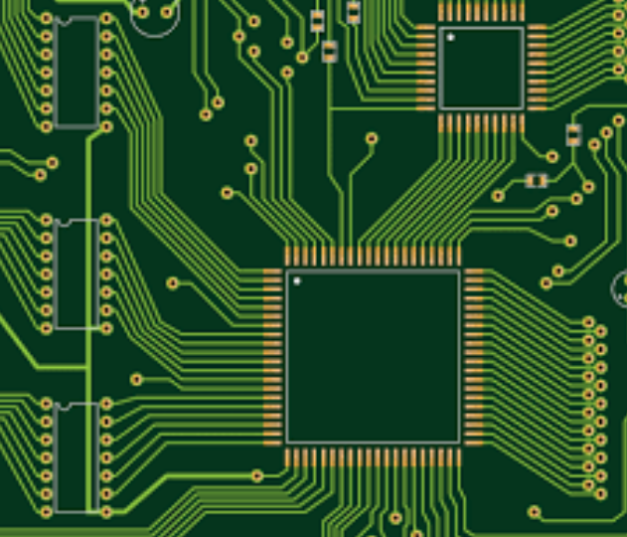
Waferscale Processors

Slide 9
Waferscale Processors
Waferscale processing could dramatically reduce communication overheads.

Slide 10
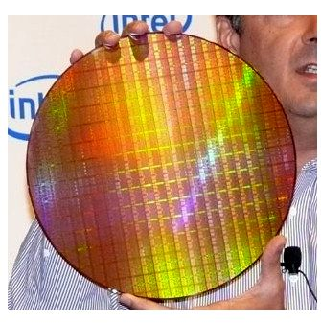
Waferscale Processors
Not new approach

Slide 11
Waferscale Processors
waferscale processors have been historically deemed impractical due to yield issues inherent to conventional integration technology.

Slide 12
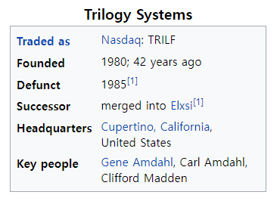
Waferscale Processors

Slide 13
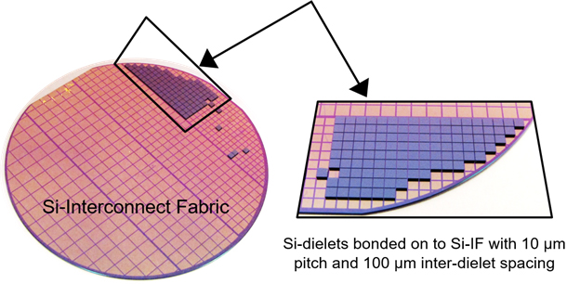
Waferscale Processors
Si-IF

Slide 14
Waferscale Processors
waferscale GPU can provide significant performance and energy efficiency advantages.
up to 18.9x speedup and 143x EDP benefit compared against equivalent MCM-GPU based implementation on PCB.

Slide 15
Waferscale Processors
Our policies outperform state-of-art scheduling and data placement policies by up to 2.88x (average 1.4x) and 1.62x (average 1.11x) for 24 GPM and 40 GPM cases respectively.

Slide 16
Waferscale Processors
Our policies outperform state-of-art scheduling and data placement policies by up to 2.88x (average 1.4x) and 1.62x (average 1.11x) for 24 GPM and 40 GPM cases respectively.

